Slide 1

WAY TO ENTERPRISE
AWS
VTI ACADEMY
Author: duy.nguyenngoc1@vti.com.vn

Slide 2
Agenda
Billing Service
EC2 Service
Assignments
Quiz
Copyright © VTI Academy All Rights Reserved

Slide 3
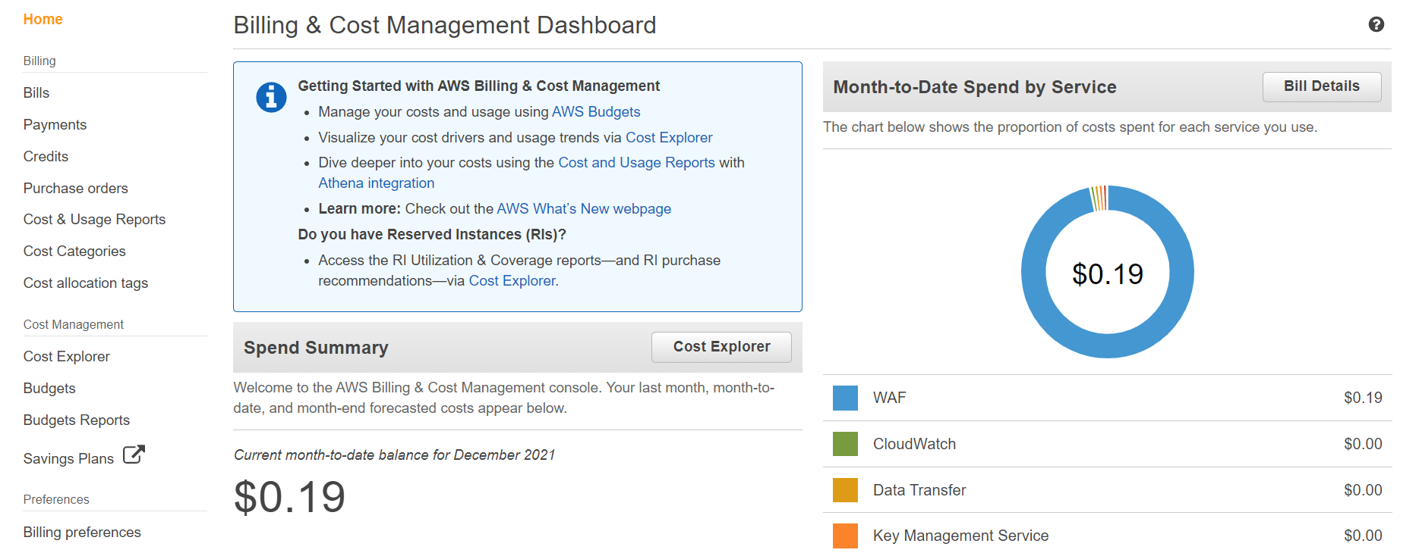
Billing Service
Cost management and payment
Export Report
Demo
  View Billing Service
  View Free Tier Services by Usage
  View Monthly Billing
  Setup AWS Budget
https://docs.aws.amazon.com/cost-management/latest/userguide/what-is-costmanagement.html

Slide 4
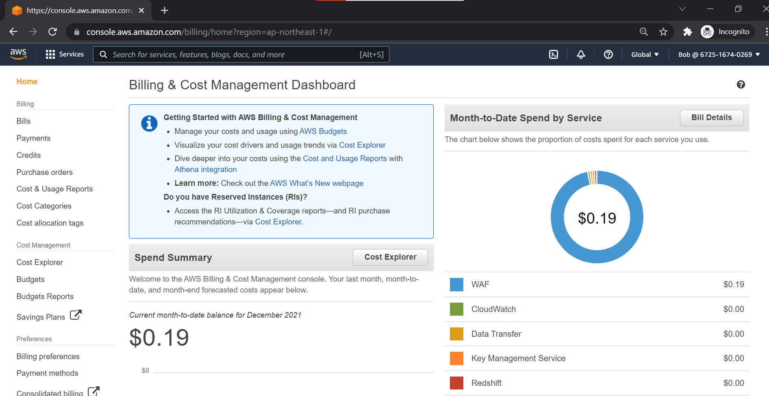
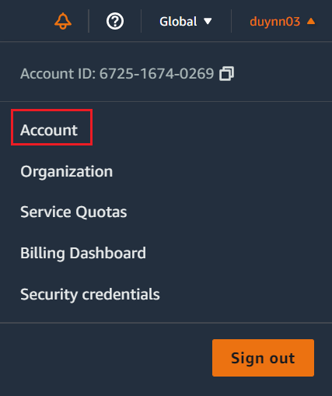
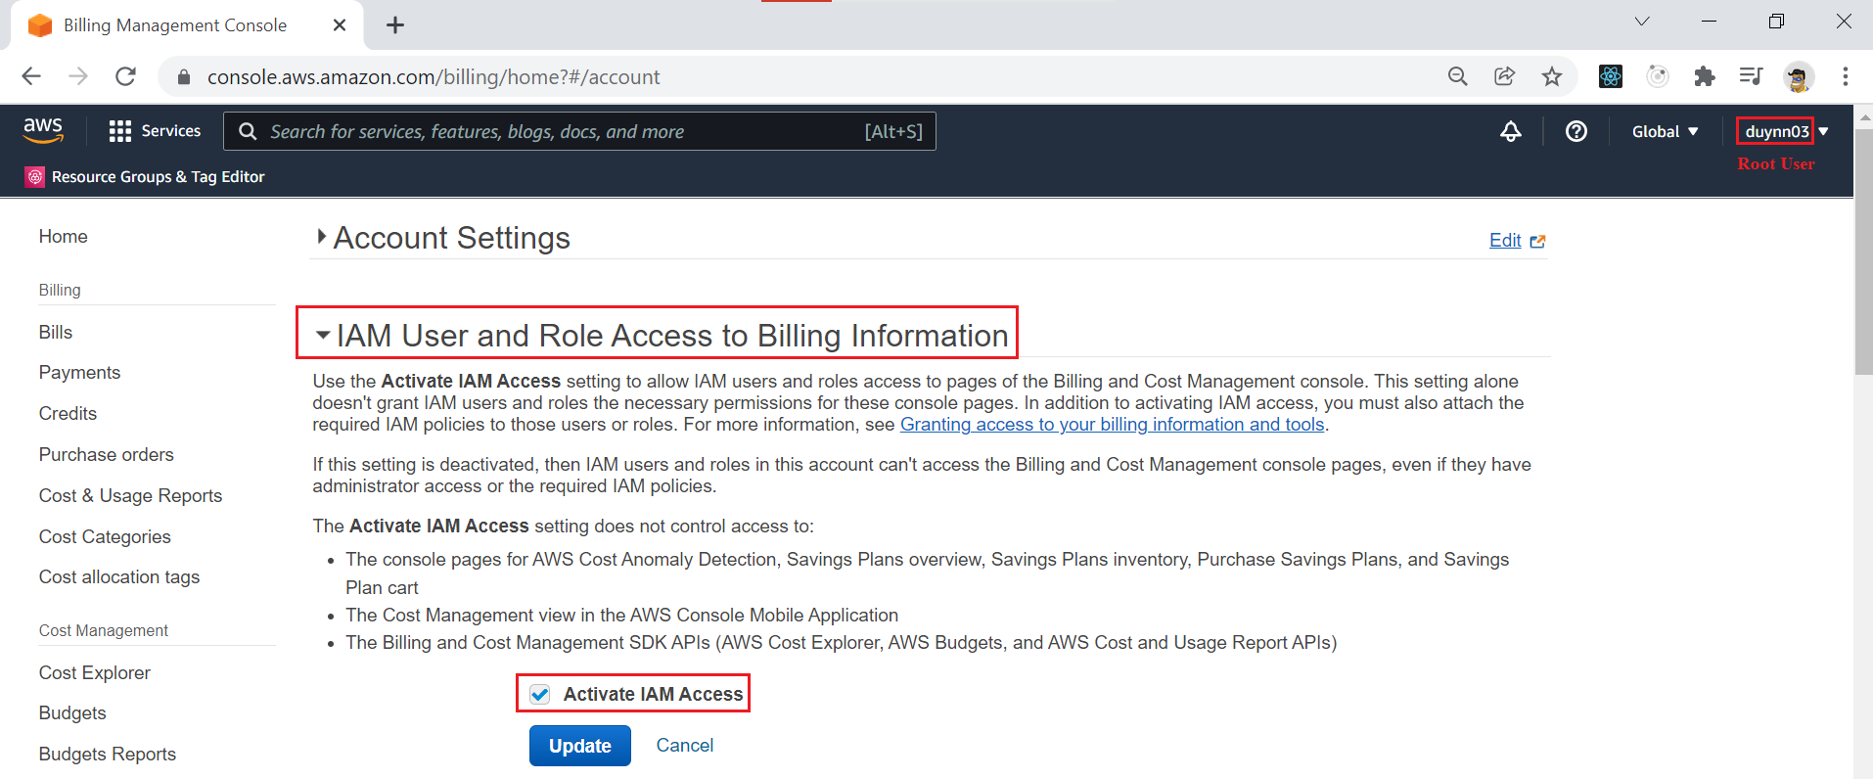
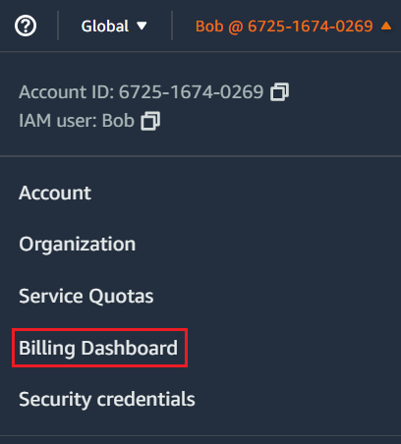
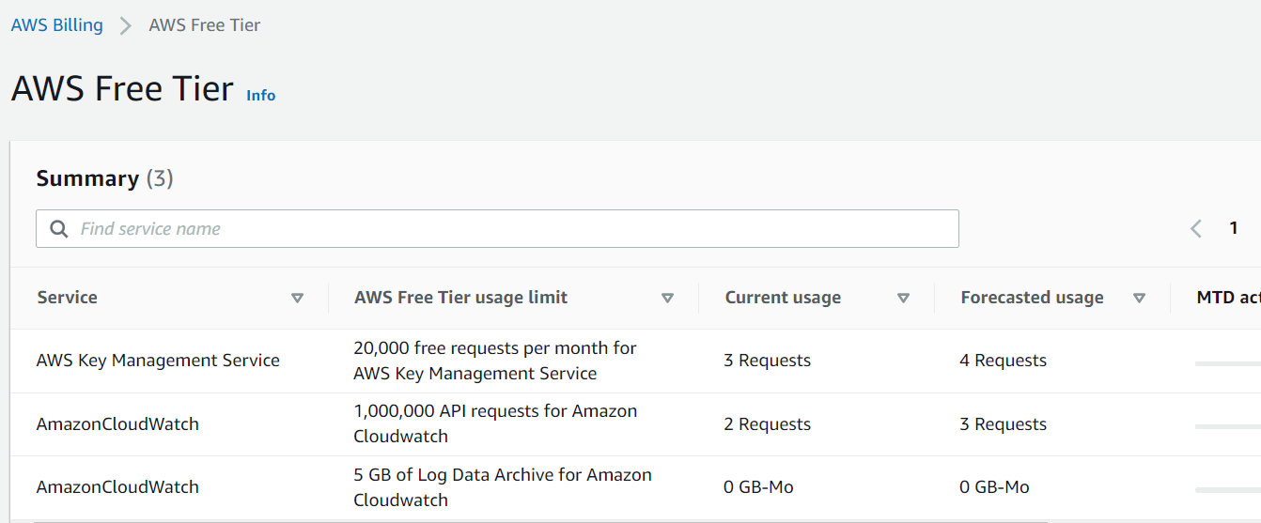
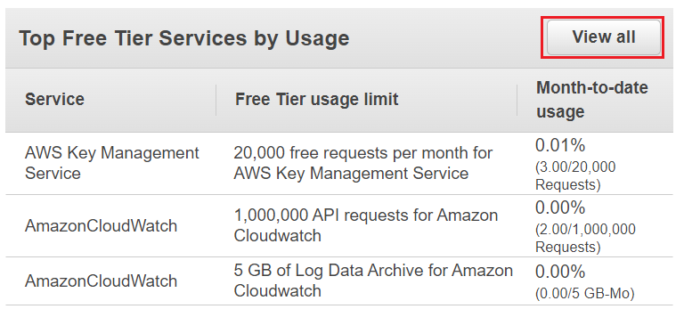
Billing Service
  View Billing Service
Root User
IAM User
  View Free Tier Services by Usage

Slide 5
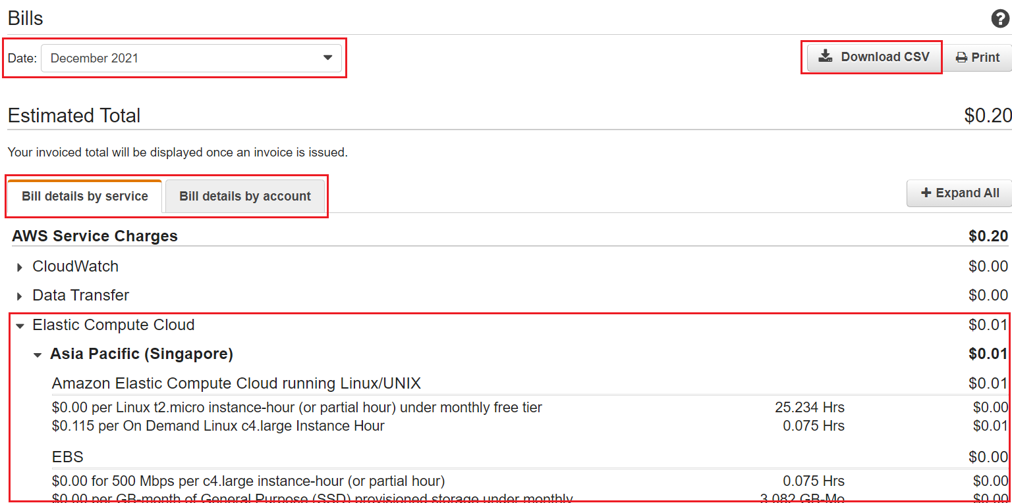
Billing Service
  View Monthly Billing

Slide 6
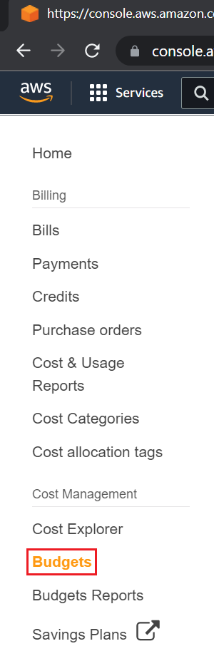
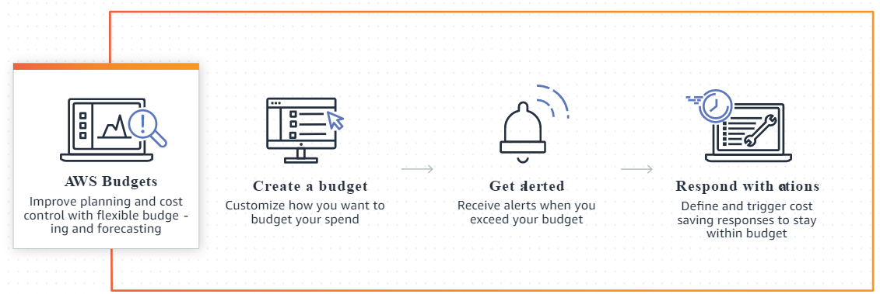
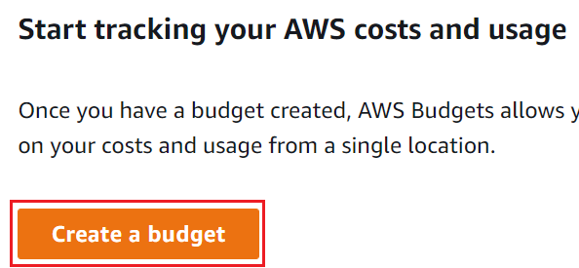
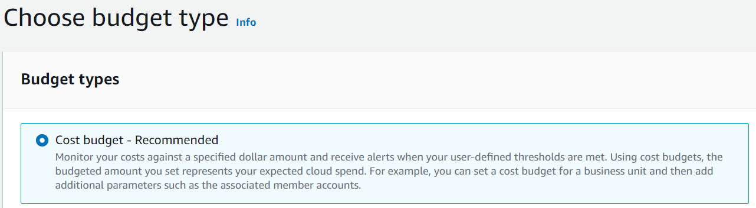
Billing Service
  Setup AWS Budget
Flow
Choose Budget Type
Create budget
https://docs.aws.amazon.com/cost-management/latest/userguide/budgets-create.html

Slide 7
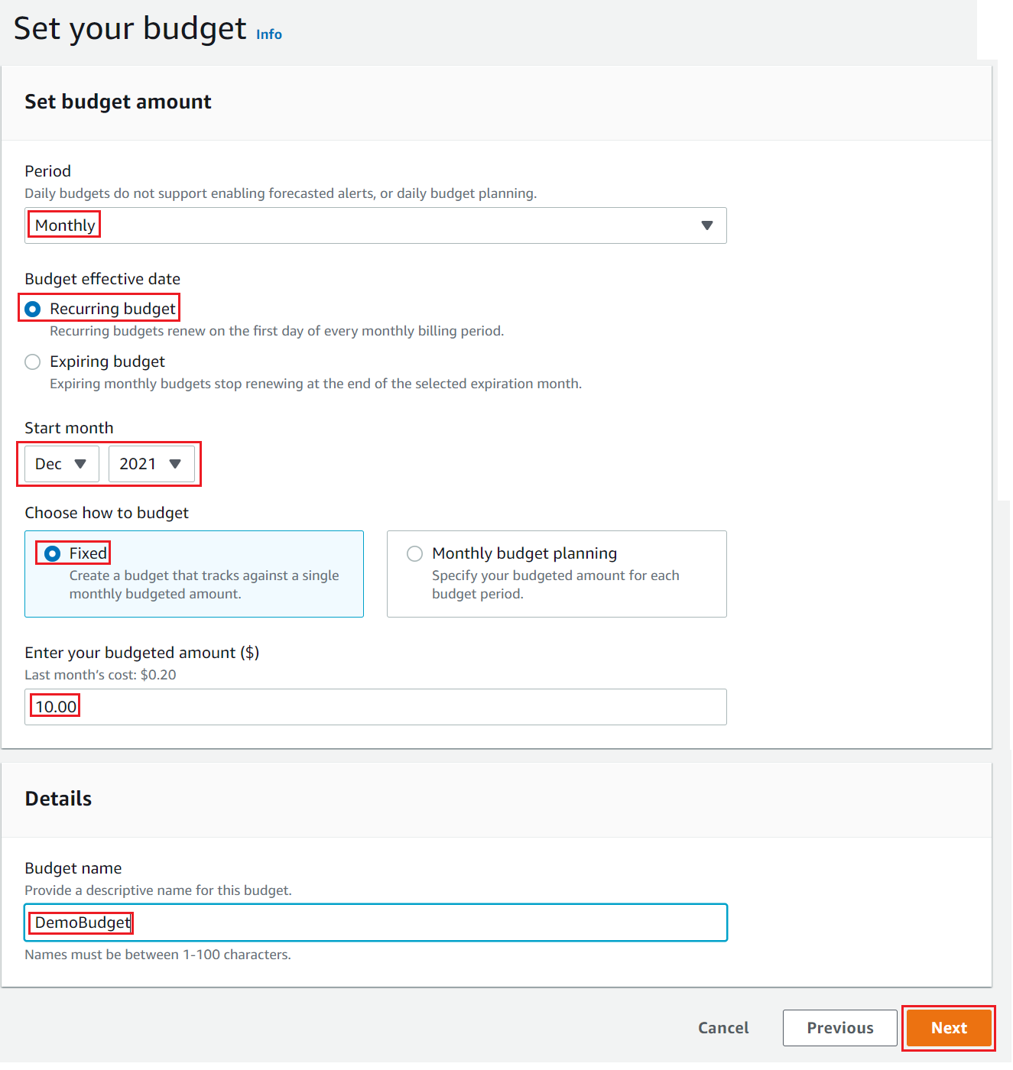
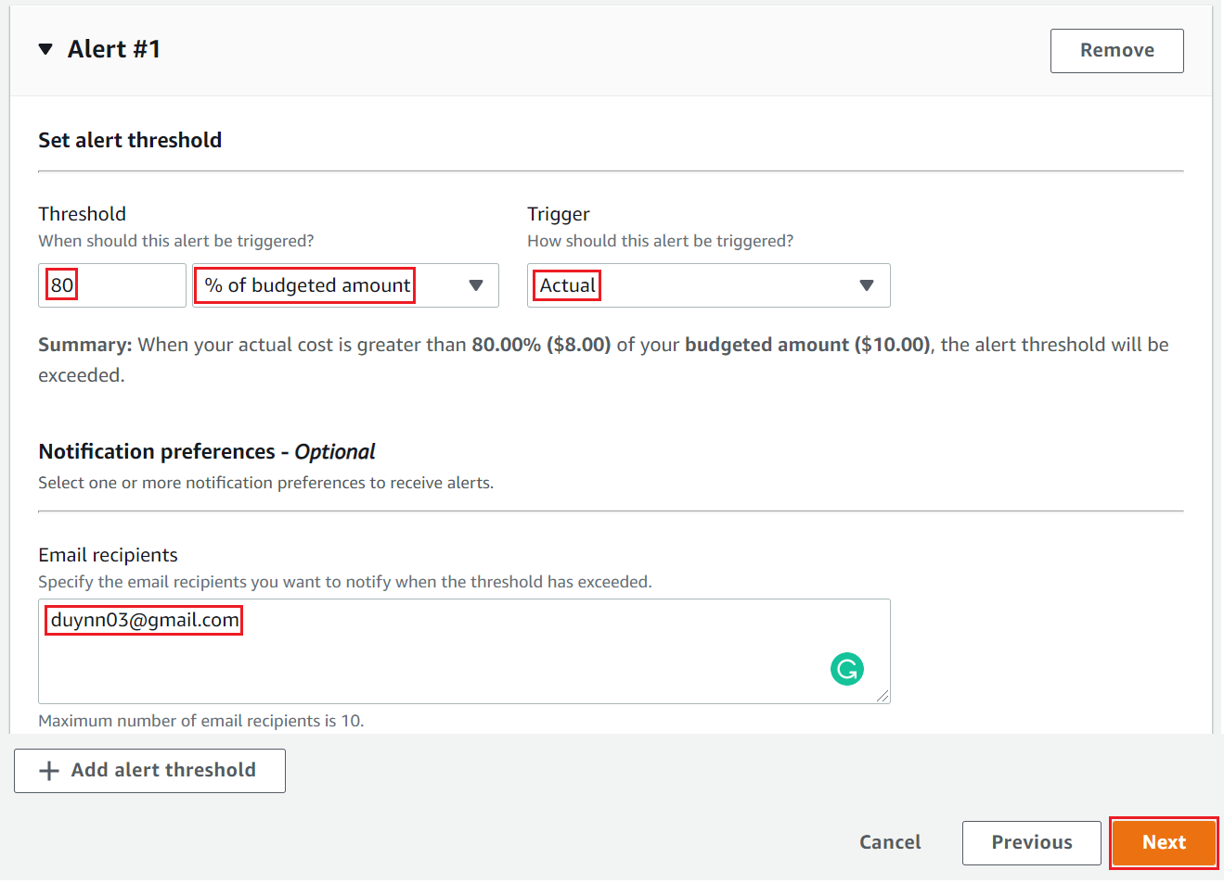
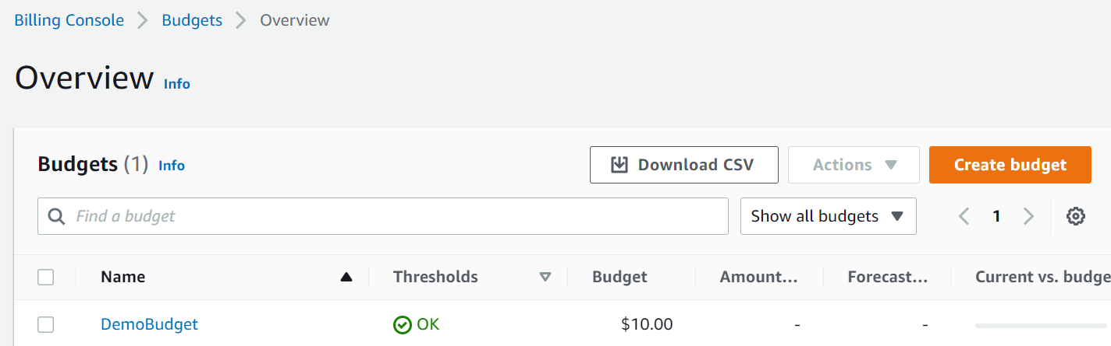
Billing Service
Config Alert
Config Budget
Result

Slide 8
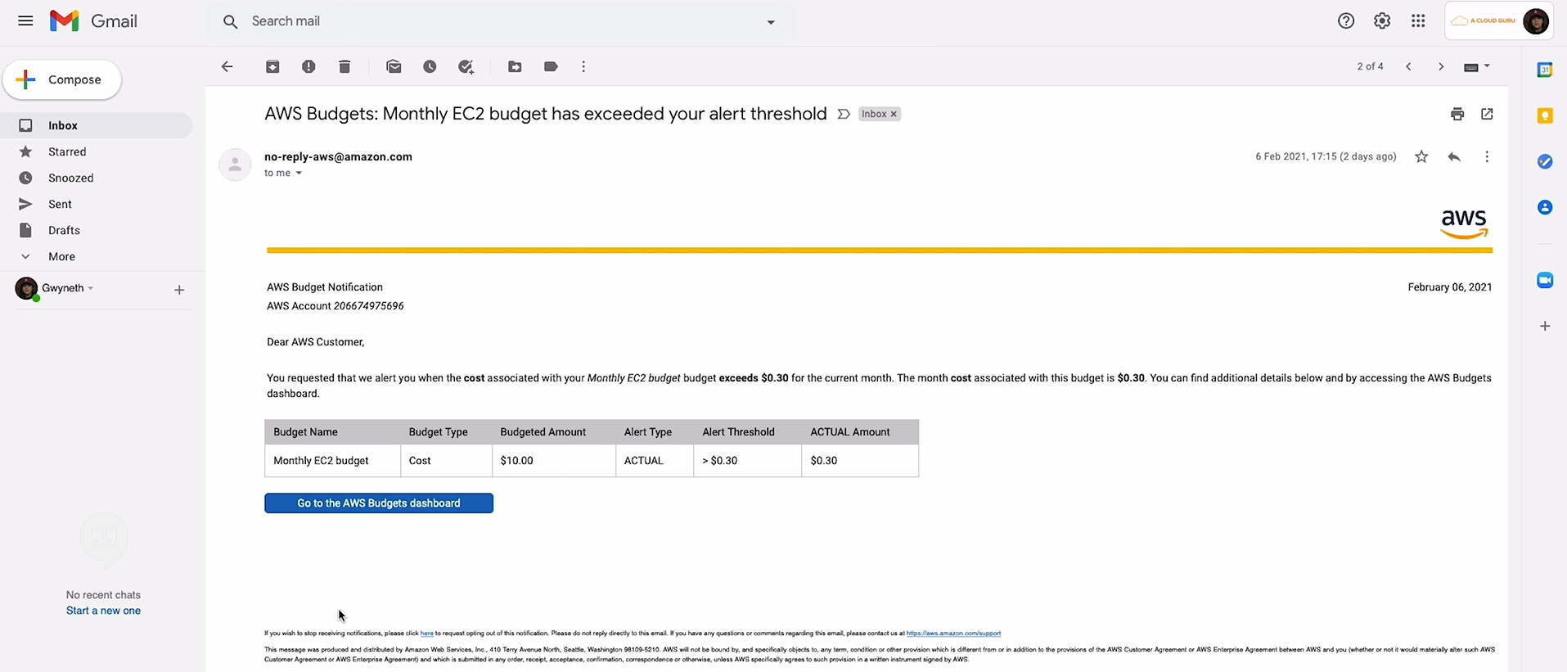
Billing Service
Email
https://www.youtube.com/watch?v=2XilJFirnWY

Slide 9
Assignment
  Self-practice

Slide 10
Q & A
Copyright © VTI Academy All Rights Reserved

